Slide 2
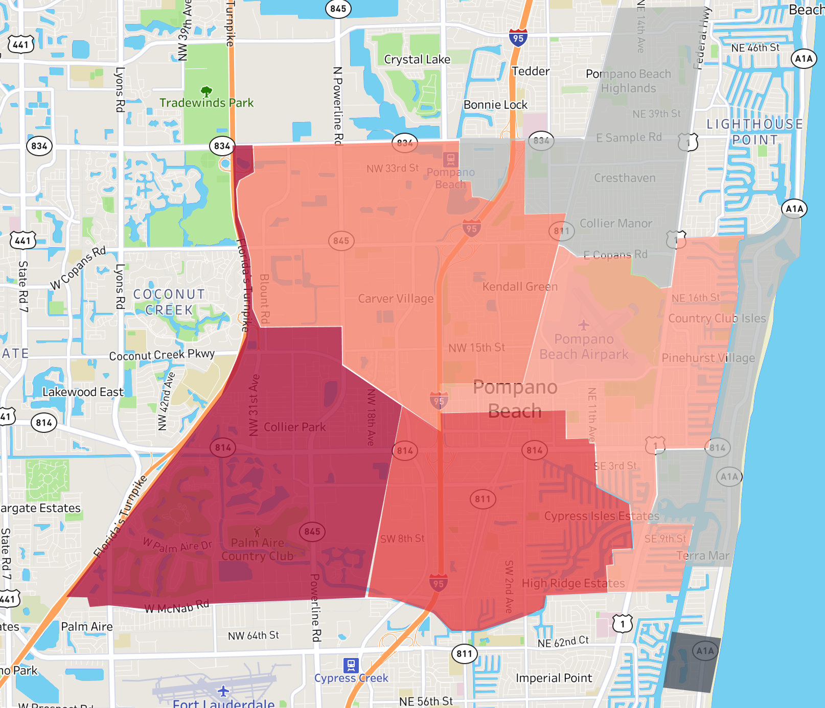
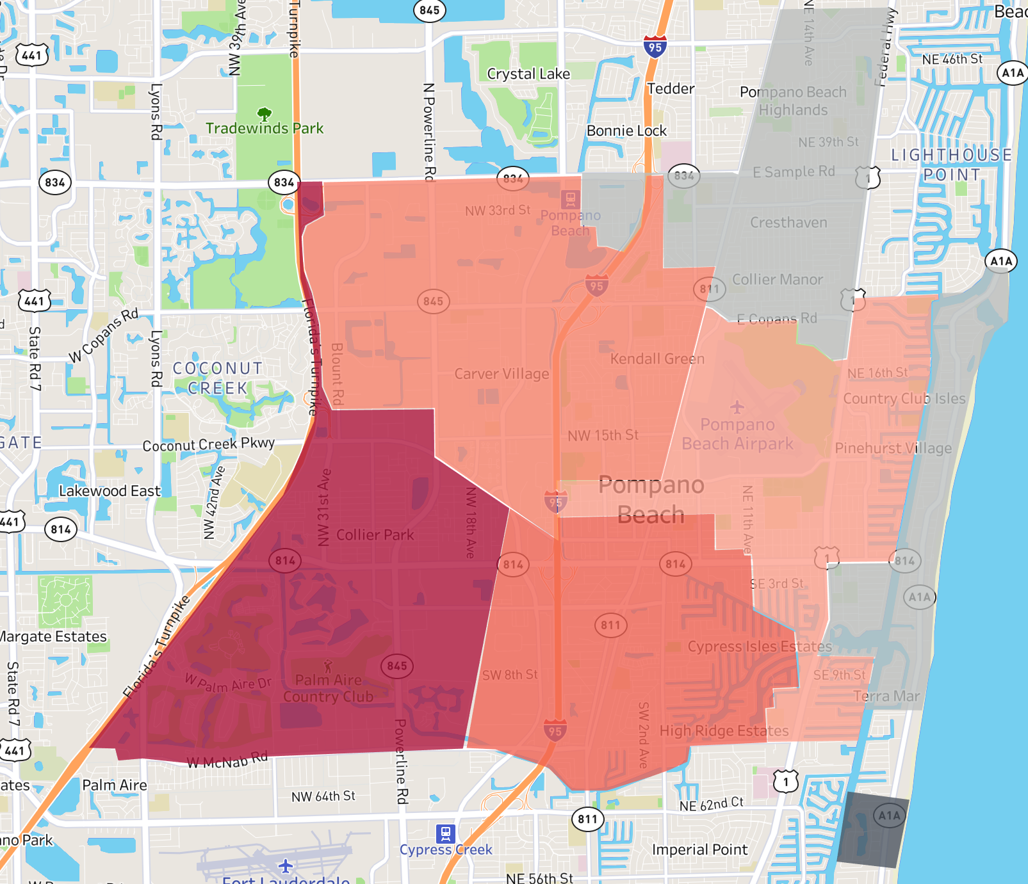
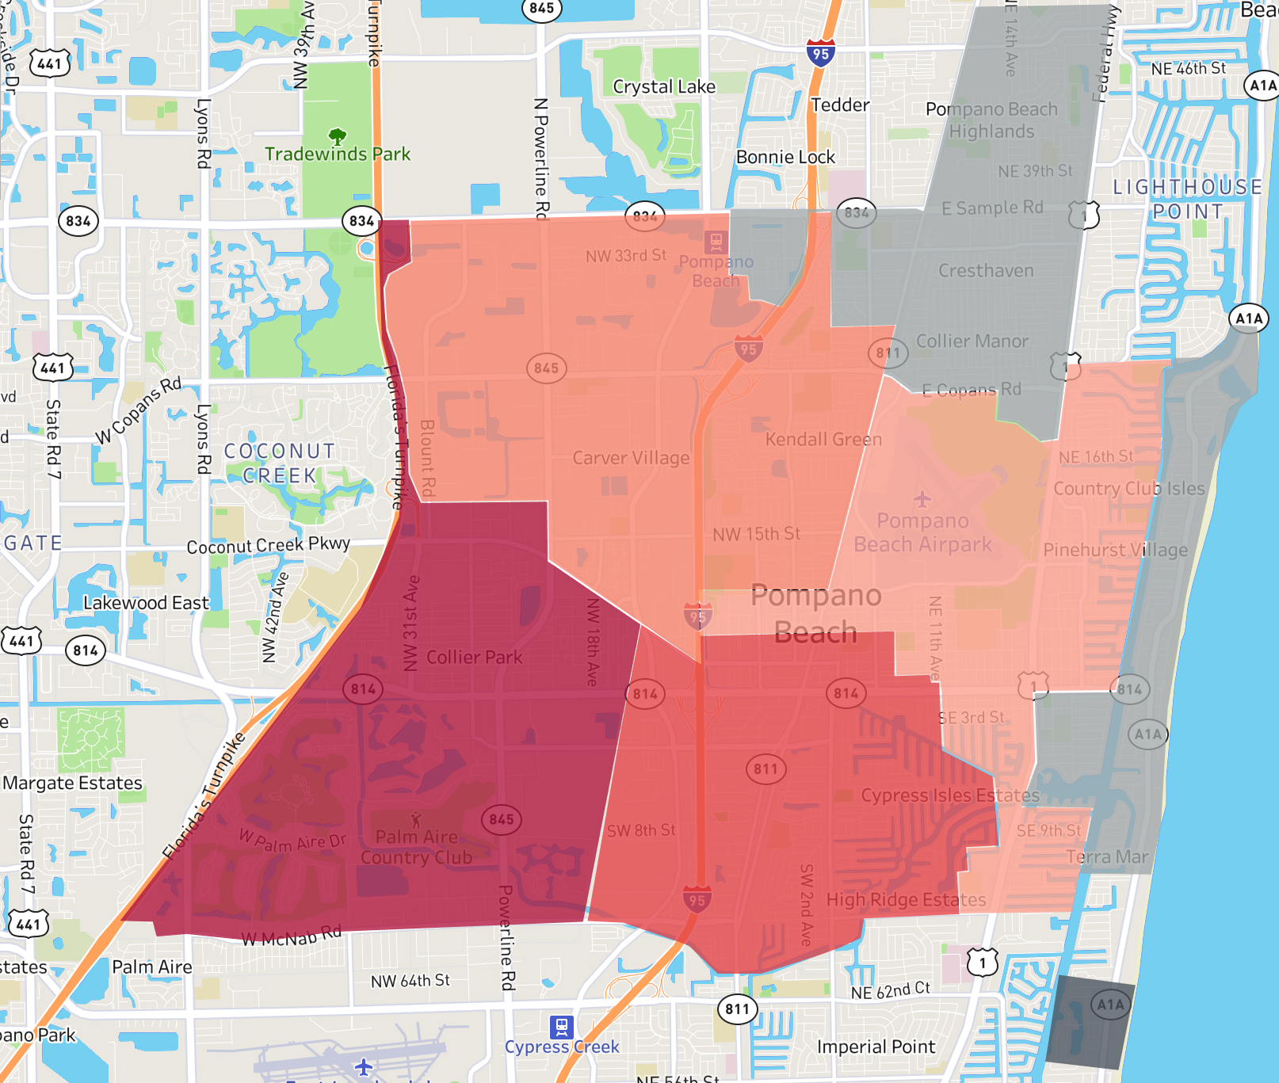
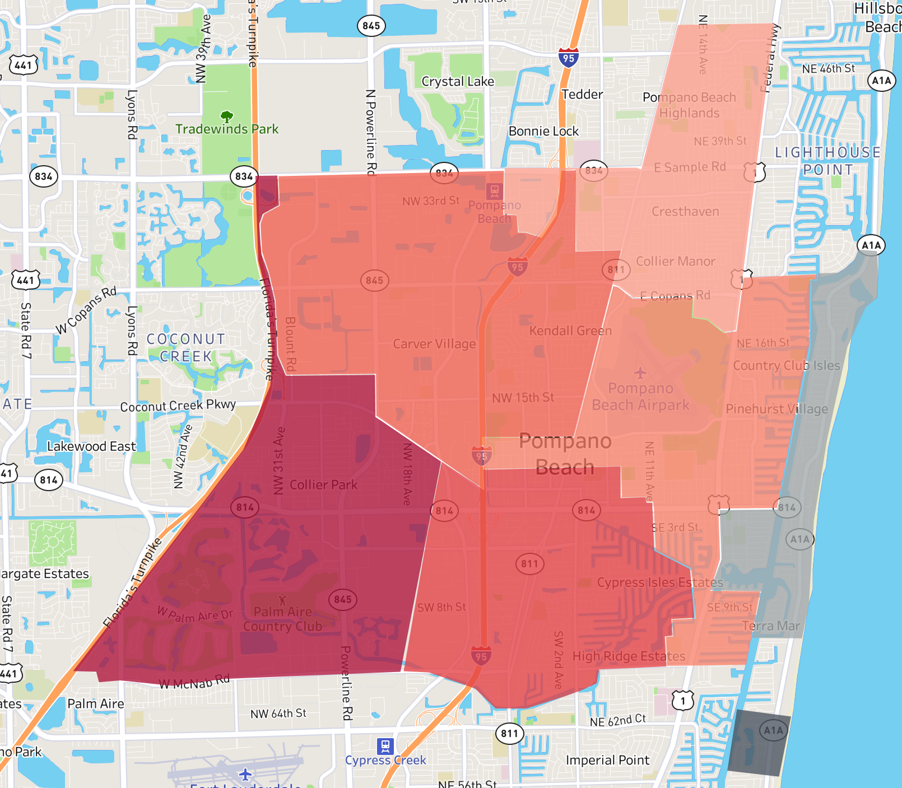
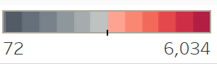
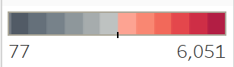
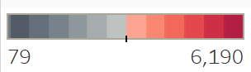
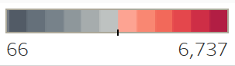
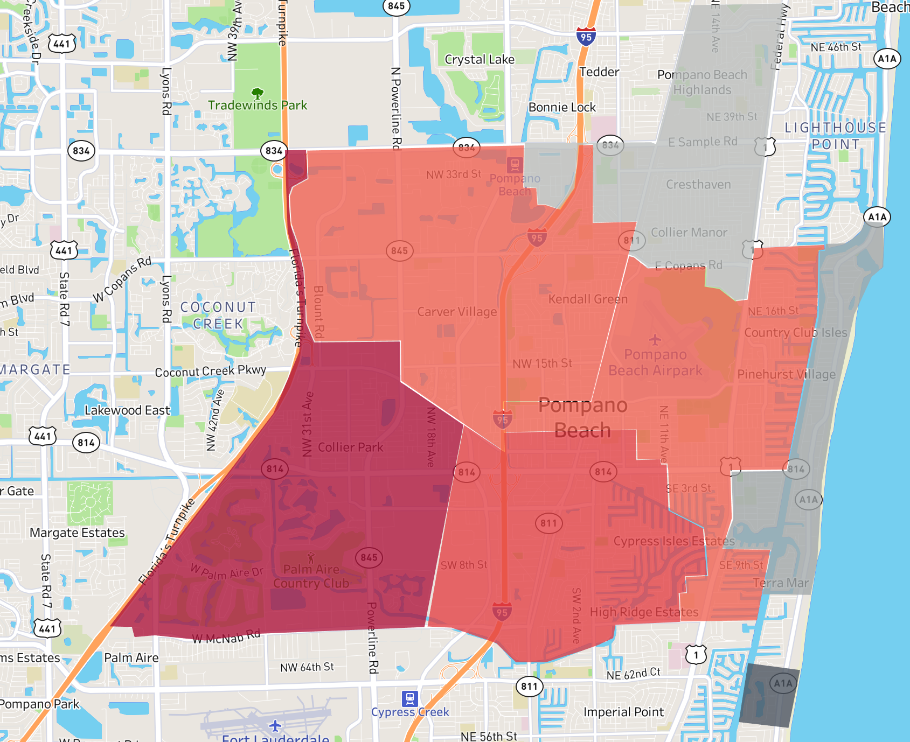
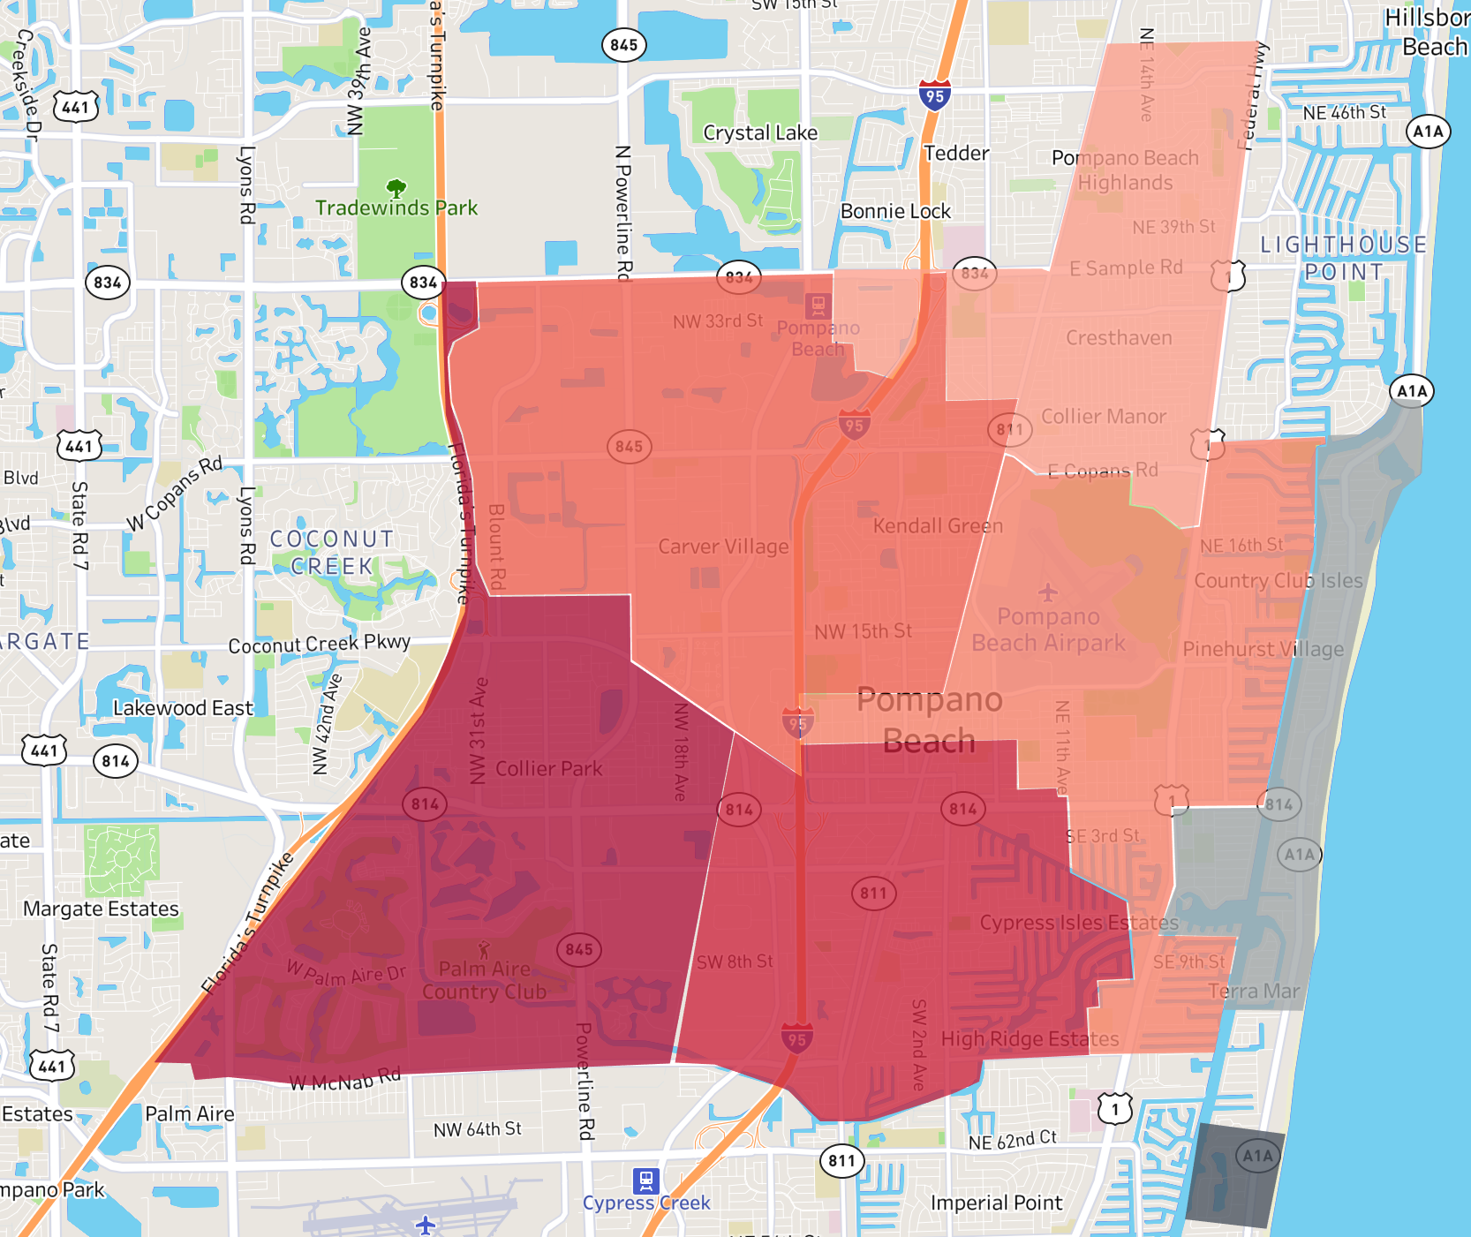
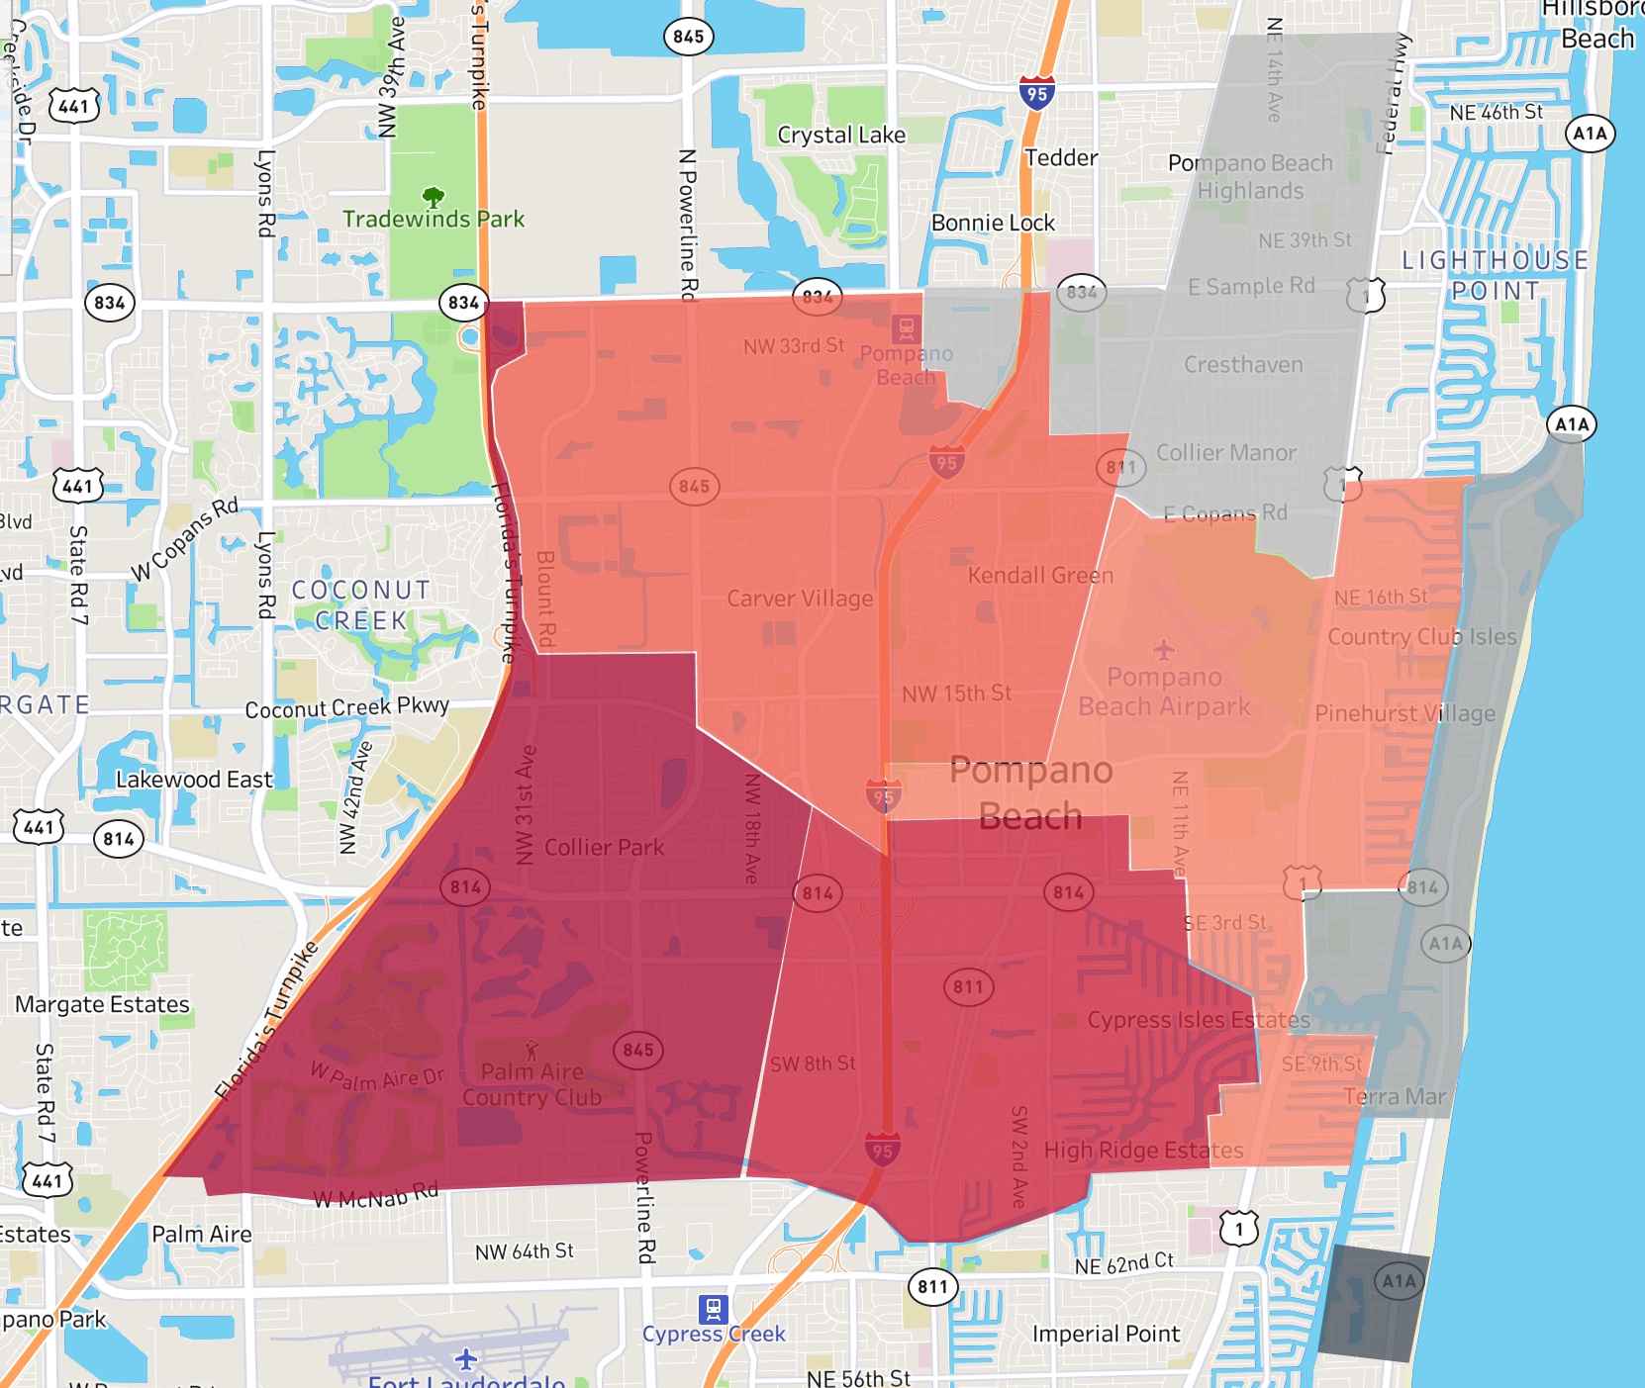
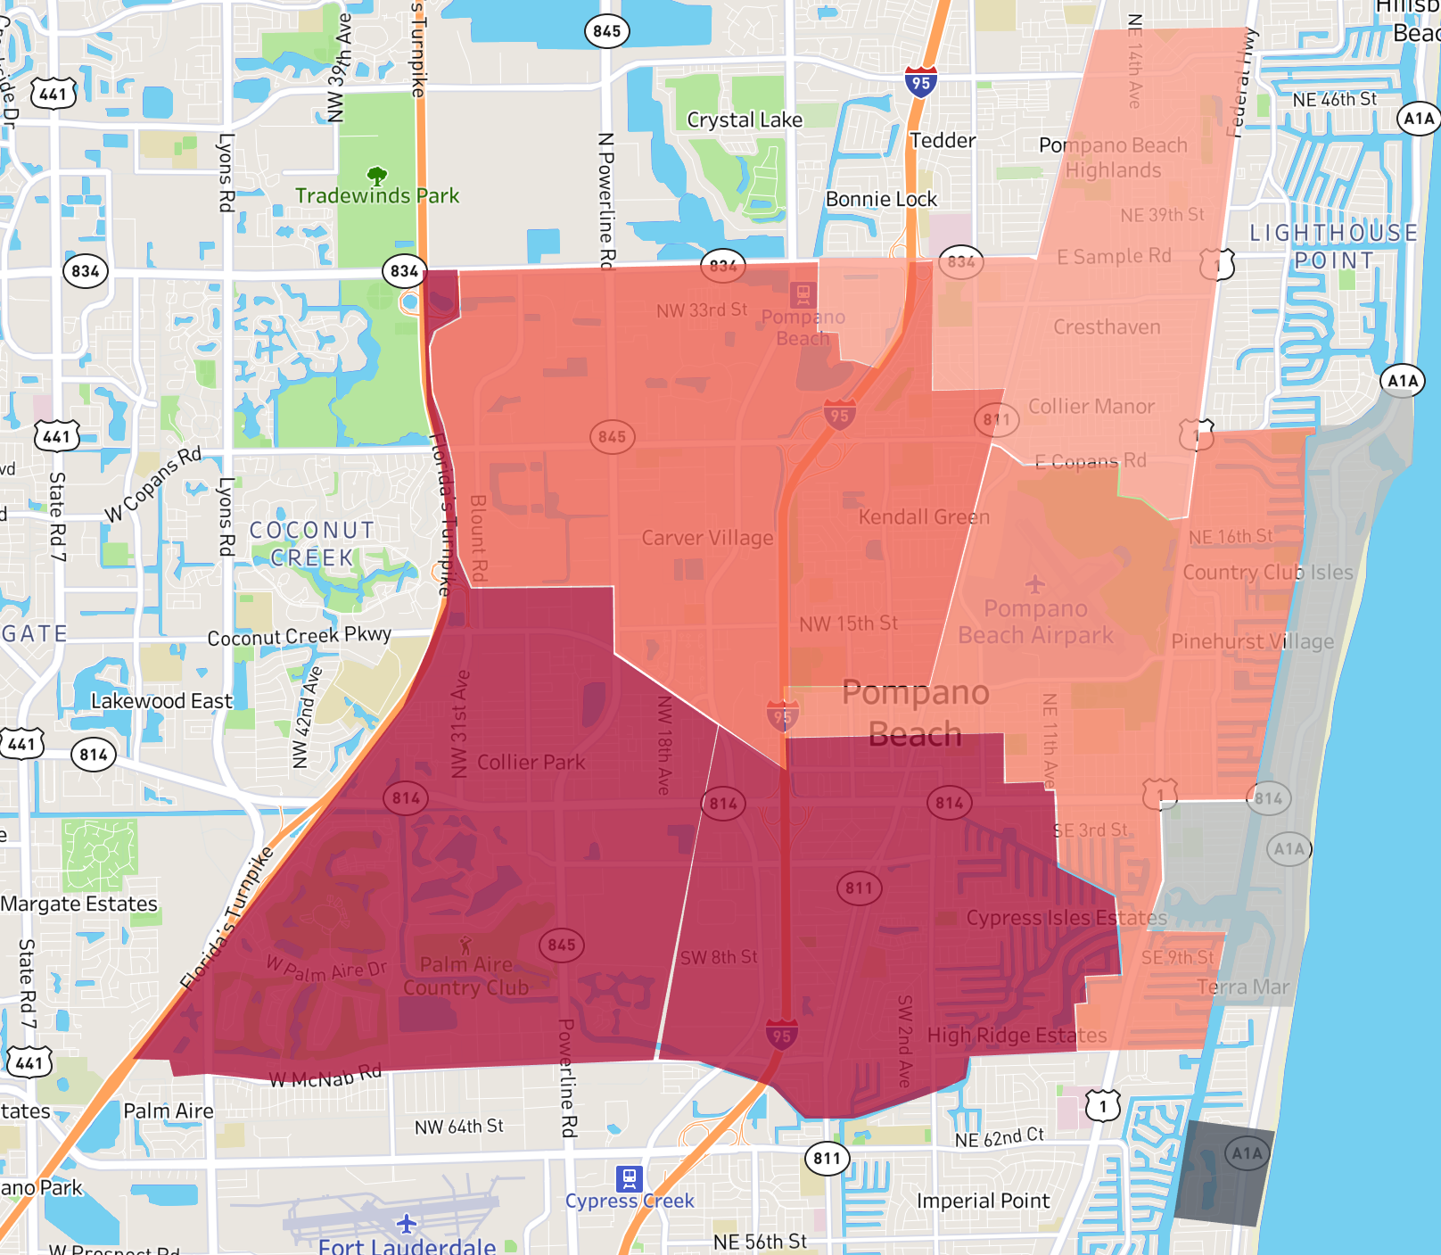
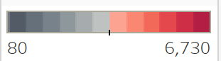
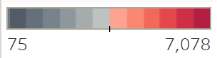
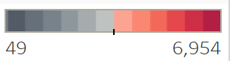
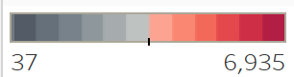
Incident Volume by Zone throughout Years
103
103
103
103
61
61
61
61
24
24
24
24
52
11
52
11
52
11
52
11
63
63
63
63
12C
12C
12C
12C
2012
2013
2014
2015
103
103
103
103
61
61
61
61
24
24
24
24
52
11
52
11
52
11
52
11
63
63
63
63
12C
12C
12C
12C
2016
2017
2018
2019

Slide 3
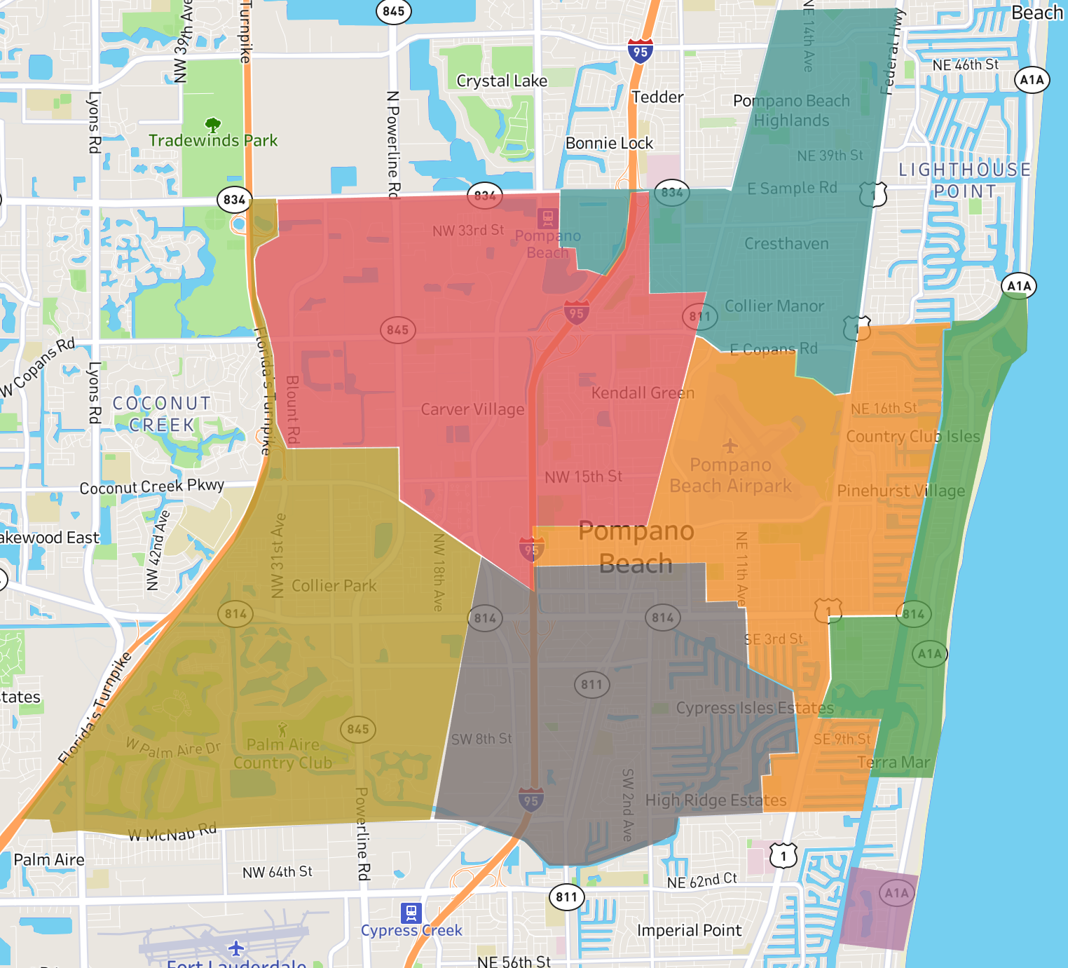
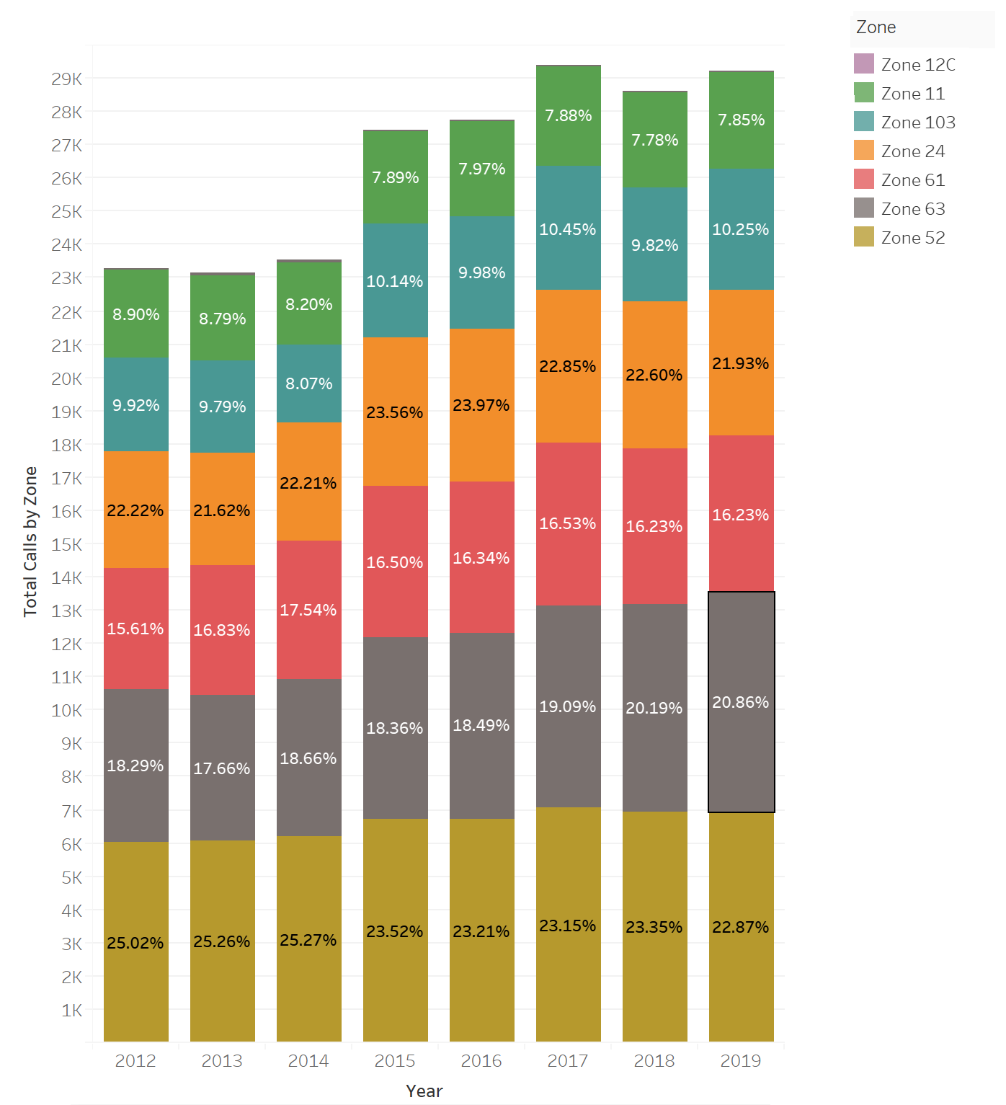
FIX image: percentages are WRONG
Distribution of Incidents throughout FD Zones
Number of Incidents by Zone throughout Years
(displays percent of total incidents for each Zone by Year)
Key Insights
Overall increase of total incidents throughout the years
Biggest increase in total number of incidents was in 2015
Zone 52 is consistently the most demanding zone accounting for a quarter of annual incidents.
However, its percent of total has declined slightly in recent years, whereas Zone 63 has been increasing
Almost half of the 2019 incidents are centered in Southwest/Southcentral Pompano Beach (Zone 52+63)
Zone 12C barely contributes to incidents
Growth
Growth rate for Zones 52, 11 and 12c are relatively stable across time
Zone 103 is the most variable (and thus least predictable) zone.
It is also the zone that saw the highest increase in incidents in 2015, with a 47% increase compared to 2014
Zone 63 has been consistently growing, with an average growth rate of 4.75% per year since 2016

